Slide 1
Dissertation Research Maturity of Cloud Application Interoperability Frameworks for Small to Medium Enterprises
John Warde D10126532

Slide 2

Motivation
Scalability
Reliability
Build for failure
Control of destiny
Notes:
Why I wanted to do this project, first from a personal point of view …
Back in 2007, I was as a Chief Technology Director and Software Architect in a small start up company with a vertical search engine product – the software we integrated with was expensive - 20 thousand sterling per CPU. However we were successful and sold the company. We re-invested some of that money in a 3 person start-up and after some researching we found open source solutions and could easily exceed price/performance using Amazon Web Services without the upfront capital expenditure on hardware. However, in 2008, due to the financial crisis, we could no longer continue as business and build on this vision. I still have that ambition to build scalable, robust web applications.
Also a secondary consideration at the time was getting locked into one provider however there were no solutions at the time. So by evaluating multi-cloud frameworks today we can better prepare start-ups prevent vendor lock-in and increase competition between Cloud Service Providers.

Slide 3

The Challenge
Literature Review
Build a Compute Intensive Reference application
Build a logging system for measurements
Build a load generator
Adapt the application to each multi-cloud framework
Use logging/measurements to confirm that application scales up/down
Review results

Slide 4

Literature Review
Breath of research covering enablers …
Virtualisation/Hypervisor
Golden master/Desired State Configuration
Design Patterns Usage, Agile development processes to build enterprise class applications
Depth of research …
Cloud interoperability approaches
Learned about the reasons for incompatibility
Automated Negotiated Service Level Agreements

Slide 5
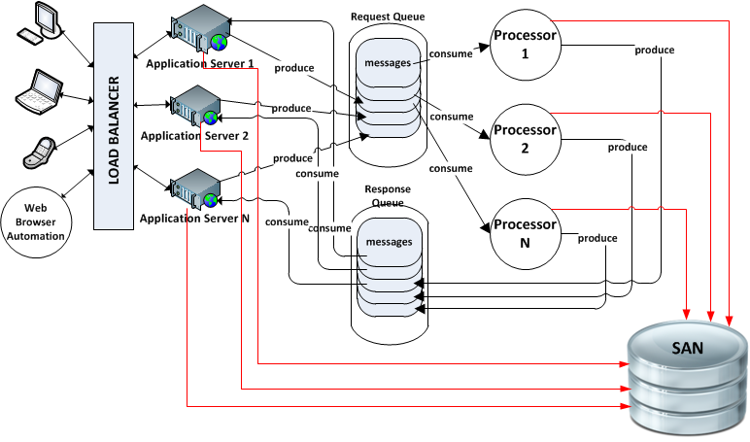
Design + logging for measurement

Slide 6
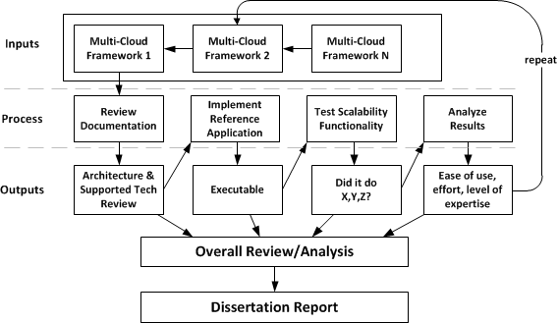
Methodology for Experiments

Slide 7

Implementation
Reference Application: learned the following technologies
Spring Framework (MVC),
ThymeLeaf template engine for building HTML/CSS pages
jQuery/AJAX
Formats in Java: REST (Request) JSON (Response)
Asynchronous Queue messaging with RabbitMQ
Supports for Experiment Measurements
Centralized Logging
Load generators (jQuery Requests, Selenium)
LiveGraph to convert log entries into graph
RabbitMQ telemetry graphs
Notes:
Spring Framework – high learning curve, took some time to get started but …
ThymeLeaf
REpresentational State Transfer (Sessions are not stored on server, useful when multiple web servers are in use)
Scalability enables the UI to stay interactive, testing on own laptop.

Slide 8

Experiment
Reviewing documentation was part of the learning process to learn how to use frameworks
Multi-Cloud frameworks
jclouds®
documentation did not match API
Brooklyn®
AWS constraints (removed)
Lack of infrastructure knowledge (SSH)
Notes:
To learn how to use the framework
Failed to complete the experiments due to time constraints

Slide 9

Conclusions
Level of expertise required
Including Infrastructure Knowledge
Multi-cloud frameworks are not in general use in Ireland
Knowledge Contributions
Multi-cloud framework awareness
AMQP Queuing Protocol, Rabbit MQ
Much to learn about multi-processing and scalable applications

Slide 10

Thanks for your time
Questions?

